Slide 1


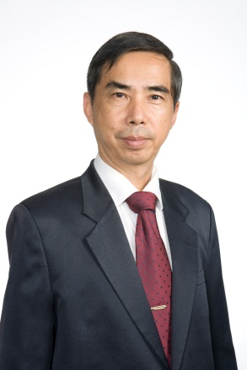

易经推介会
主讲者： 沈树圭老师(新加坡易经研究会会长)
日期 ： 06/10/2013（星期六）
时间 ： 2:00pm– 4:00pm
地点 : 醉花林俱乐部（庆利路190号）
学费 ： 入场免费、座位有限、敬请报名订位
课程内容：
（一） 什么是《易经》？
（二）《易经》是什么样的书？
（三）《易经》如何给一个人定位？
（四）《易经》八卦与人生？
(五）《易经》哲理与应用，股票投资
（六） 结论
沈树圭个人简介：
国际著名易学专家，新加坡易经研究会创会会长及现任会长，新加坡易经应用学院院长，国际易学协会会长，国际易学大会常务会长兼署理秘书长，亚细安易学研究所所长，全球易文化大会主席团主席，国际道商文化研究院副院长，新加坡同济医院董事兼文教组副主任，新加坡中医学院客座讲师，新加坡易经风水文化企业风水总策划师，2006年获选为全球百名具影响力的易学界人物之一。
有兴趣参加者，请致电6253 0111联络lena小姐报名，或传真报名表格至6256 9672，或电邮至culture@chlc.sg
易经哲理与应用班报名表格
姓名： 电话：H/P： 电邮：____________
新加坡庆利路门牌一百九十号|190 Keng Lee Road, Singapore 308409
T:+65 6253 0111 F:+65 6256 9672 |www.chuihuaylimclub

Slide 2
Talk on I-Ching
Speaker：Mr. Bernard Sim(President, I-Ching
Research Assoication,Singapore)
Dates ：06 October 2013 (Saturday)
Time ：2.00pm-4:00pm
Venue : Chui Huay Lim Club,190 Keng Lee Road
Fees ：Please register early as there are limited places for this free talk
Topics ：
1.What is I- Ching?
2.How is I-Ching related to Book of Change?
3.How I-Ching can determine a Person’s Status?
4.I-Ching Eight Trigrams and our life circle.
5.I-Ching Theory and Application,Forcast Stock Market Movements with I-
Ching principles
6.Conclusion
Sim Soo Kwee Resume
•International I-Ching Expert
•Founder & President of I-Ching Research Association(Singapore)
•Dean of I-Ching Application Centre
•Executive President cum Deputy General Secretary of International I-Ching
Conference
• Dean of Asian I-Ching Research Centre
•Chairman of World I-Ching Cultural Conference
•Deputy Dean of International Taolistic Business Culture Accademy
•Deputy Head,Educational and Cultural Committee of Singapore Thong Chai Medical
Institution
•Affliated Lecturer of Singapore College of Traditional Chinese Medcine
•Grand Master of I-Ching Fengshui Consultant
•Conferred in 2006 & 2009 by Macau Hua Ren News to be one of the World 100
most influential I-Ching Experts
If you would like to participate, please dial the hotline at 62530111 and contact Ms Lena to register or you could fax the registration form to 62569672. Another alternative would be to directly email us at 1845chlc@gmail.com.
I-Ching Theory And Practice Class Registration Form
Name: _____ H/P: ____ Email:____________

